Slide 1
Green Thumb Growers Guild: a gardening and horticulture group at Sidney Elementary School
Presentation to the
Hill and Valley Garden Club of Sidney
March 2015

Slide 2
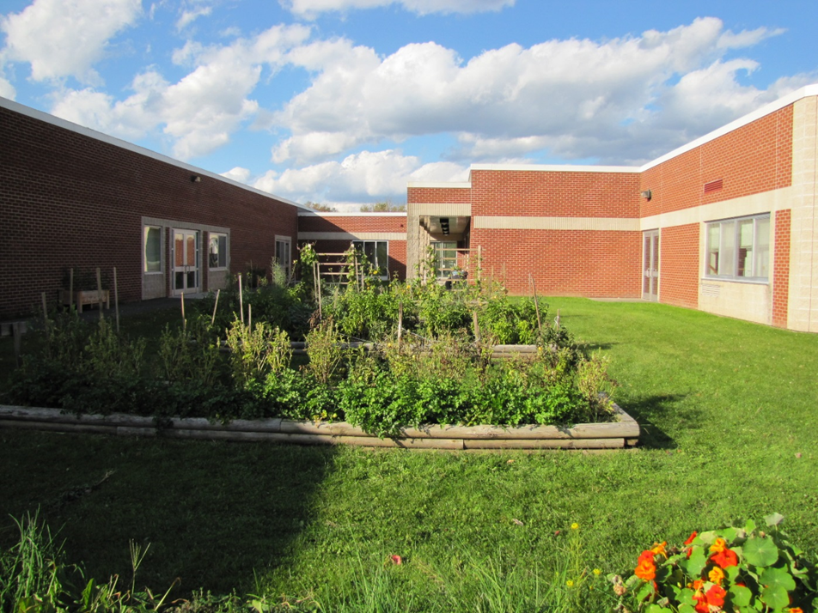
Sidney Elementary Gardens

Slide 3
Summer/Fall Veggie Harvesting

Slide 4
Summer/Fall Veggie Harvesting

Slide 5
Summer/Fall Veggie Harvesting

Slide 6
Green Peppers

Slide 7
Healthy Cooking

Slide 8
Nature Walks

Slide 9
Vermicomposting
Worms

Slide 10
Eat Fresh Taste Test
Asparagus

Slide 11
Eat Fresh Taste Test

Slide 12
Eat Fresh Taste Test
Sweet potatoes

Slide 13
Eat Fresh Taste Test

Slide 14
Designing Tote Bags

Slide 15
Designing Tote Bags

Slide 16
Construction: Planters for garden

Slide 17
Thank You!

